Slide 1
Using Elsevier ClinicalKey Student to teach MBBS Students remotely
Notes:
Hello Everyone, A Very Good Afternoon, Welcome to our session on “Using Elsevier ClinicalKey Student to teach Undergraduate Medical Students remotely”.

Slide 2
Challenges institutes and faculty are facing with Remote teaching during COVID-19 times
Urgency to provide students with a virtual learning environment
Limited physical access to Library, textbooks, notes, PPTs, Question papers and other resources
Train all faculty to conduct remote teaching and assessments
Search for easy-to-use online tools with standard and globally trusted UG textbooks as well as quality resources
Notes:
DR RAO: With the rapid spread of COVID-19, educators across the country and globe have been tasked with shifting to emergency remote teaching—a move from in-person to remote classes made necessary by pressing circumstances. This quick move has left educators scrambling to figure out how to use digital tools, online resources, and apps to continue their teaching at a distance/ remotely. Unfortunately, across the board, educators have not been prepared to teach well with technology, let alone teach remotely.

Slide 3
The next generation medical students
Self learner/explorer.
Collaborative.
Digital immersed and Digital Natives.
Visual and experimental.
Notes:
Dr PRAGNA RAO: The good thing here is that we don’t need to train our students who are Digital natives, who live in an online world . Also don't forget that your students ,are academically the best minds in the country. They are hungry to learn and soon they're going to have lots of ideas themselves about
what they'd like to do, and how they'd like to learn remotely. Share those ideas with them, take them onboard and keep them motivated
Now let’s hear from Smruti what’s in from Elsevier for remote teaching and learning. Over to you, Smruti

Slide 4
YOU are an experienced and an effective teacher
You know, your students well, and they want to see and hear from you and be guided by you.
Notes:
Dr Rao: It doesn't matter that teaching is not happening face to face at the moment. It can be by video
and audio, but they're going to be very appreciative for what you do. And they're going to understand things may not work first time, or every time. There maybe
some hiccups, it doesn't matter. So we are here to help you make the transition to remote learning.

Slide 5
Faculty and Student Hub
Faculty & Student Hub
UG teaching-learning virtual platform which hosts 500+ textbooks, 150K+ images, 850 videos,
cases and ready-to-use MCQ bank
Updated weekly, these Elsevier resource centers have additional free resources to teach remotely. 3DAnatomy lectures, mini cases, activity sheets
Notes:
Smruti: To help institutes, faculty and students implement remote learning, as most of you are already aware of, Elsevier is offering CK Student and an additional faculty + student hub, at no cost, till Jun 2020.
ClinicalKey Student(CK Student), our virtual teaching-learning platform that provides access to 275+ global + Indian hundreds of textbooks, study tools and video resources, to you and students, at no cost, until end of June 2020. During this time CK Student will support self-study/ self-directed learning of your students by enabling them to set self-assessments to monitor and progress their learning. It will allow you to create digital learning materials and send reading assignments to students.
In addition, we have also curated a selection of UG medical resources (anatomy lectures, mini cases and activity sheets) to supplement your remote teaching strategies in a faculty hub (https://www.elsevier.com/education/health-faculty-hub) and student hub (https://www.elsevier.com/solutions/clinicalkey/faculty-and-students/hub) that you can utilise to engage students as they learn from home. We will be updating the hubs with new content weekly and will provide links to informative webinars hosted by your peers, sharing best practise approaches to teaching remotely.

Slide 6
Your companion to teach MBBS students
Foundation capabilities
Assessment capabilities
500+ trusted UG textbooks: global and Indian
150000+ © cleared downloadable images
2000+ dissection and clinical exam videos
1500 Synoptic Quick access summaries
150+ hours clinical and practical skills videos
Formative and Self assessment tool
Ready MCQs bank in all MBBS subjects
Curated by expert educators and doctors
Know “areas-of-improvement” “at-risk-student”
Trusted inline and linked remediation content
Mobile Access and Book Shelf App
Elsevier Super Google
“Search Engine”
“Instant Personalized Feedback” Superpower
Notes:
Smruti: CK Student is an Elsevier virtual teaching-learning platform, live and available commercially since 2018 and will continue to be live beyond Jun 2020.
It’s an universe of the most trusted collection of undergraduate medical content pulled in from Global textbooks, Indian textbooks, 85K Images, Clinical Exam Videos and Dissection Videos, along with ready-made QB. Has PPT maker, assignment maker and assessment tools
Simply put – Super google for ug from elsevier + assessment tool with intelligent dashboard
Due to the IT constraints during the times of COVID, certain features may not be available like….

Slide 7
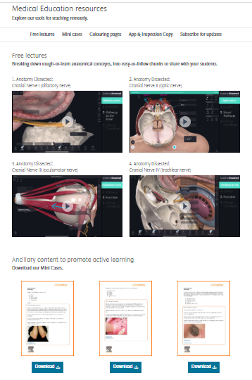
Complimentary faculty hub
Updated weekly, these Elsevier resource centers have additional free resources to teach remotely - 3DAnatomy lectures, mini cases, activity sheets
Will share webinars from your peers, conducting remote teaching, from across the globe
Notes:
Smruti: A quick look at the faculty hub for you
https://www.elsevier.com/education/health-faculty-hub
https://www.elsevier.com/solutions/clinicalkey/faculty-and-students/hub
Will be happy to add your experiences as well

Slide 8
Notes:
Smruti

Slide 9
Thank You and Stay Safe!
Vikram Sudhakar
Email: v.Sudhakar@elsevier.com
Phone: 9999051396

